Slide 1
CS 471-1/571
Ch10 The Requirements Workflow

Slide 2
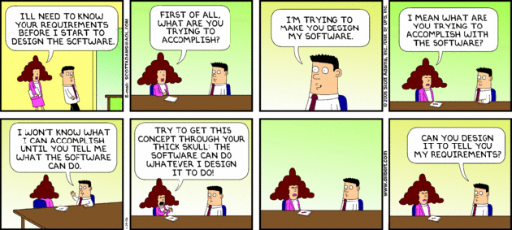
“I know you believe you understood what you think I said, but I am not sure you realize that what you heard is not what I meant!”

Slide 3
Overview
Overview of the requirements workflow
Understanding the domain
Building the business model
Determining the initial requirements
A Case Study
Requirements and rapid prototyping
Other issues

Slide 4
The Aim
To answer the question: What must the product be able to do?
Misconception: we must determine what the client wants
We must determine what the client needs
It is hard for a systems analyst to visualize a software product and its functionality
The problem is far worse for the client.
A skilled analyst is needed to elicit the appropriate information from the client.

Slide 5
Overview of the Requirements Workflow
First, gain an understanding of the application domain
The specific environment in which the target product is to operate
Second, build a business model
Model the client’s business processes
Third, use the business model to determine the client’s requirements
Iterate the above steps
Notes:
Requirements elicitation (or capture)
Discovering the client’s requirements
Methods include interviews and surveys
Requirements analysis
Refining and extending the initial requirements

Slide 6
Understanding the Domain
Every member of the development team must become familiar with the application domain
Correct terminology is essential
Construct a glossary
A list of technical words used in the domain, and their meanings
Jargon: words that are meaningless outside of a certain context or particular group.
Radio: 10-4 (Okay or I understand)
Internet: IANAL(I am not a lawyer), LOL (Laugh out loud)
Mortgage: escrow?

Slide 7
Building Business Model
A business model is a description of the business processes of an organization
The business model gives an understanding of the client’s business as a whole
This knowledge is essential for advising the client regarding computerization
The systems analyst needs to obtain a detailed understanding of the various business processes
Different techniques are used, primarily interviewing

Slide 8
Interviewing
The requirements team meet with the client and users to extract all relevant information
In a structured interview, specific preplanned questions are asked, frequently close-ended
Close-ended questions require a specific answer
In an unstructured interview, questions are posed in response to the answers received, frequently open-ended
Encourage the person being interviewed to speak out

Slide 9
Interviewing (contd)
Interviewing is not easy
An interview that is too unstructured will not yield much relevant information
The interviewer must be fully familiar with the application domain
The interviewer must remain open-minded
After the interview, the interviewer must prepare a written report
Give a copy to the person who was interviewed

Slide 10
Other Techniques
A questionnaire is useful when the opinions of hundreds of individuals need to be determined
Examination of business forms shows how the client currently does business
Direct observation of the employees while they perform their duties can be useful
Videotape cameras are a modern version
Notes:
Interviewing is the primary technique

Slide 11
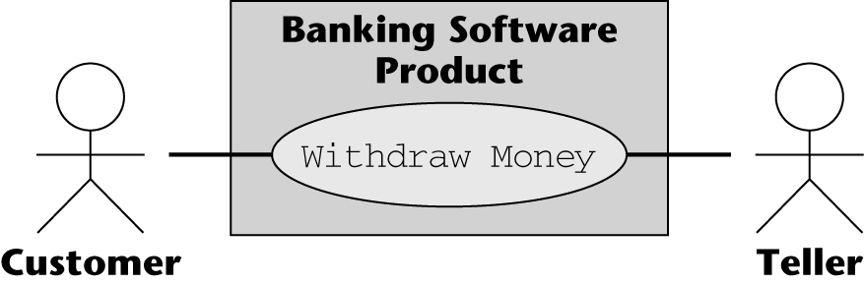
Use Cases
A use case models an interaction between the software product itself and the users (actors) of that software product

Slide 12
Actor and User
An actor is a member of the world outside the software product
A user, an initiator, or someone who plays a critical part
A user can play more than one role
A bank customer can be a Borrower or Lender
One actor can participate in multiple use cases
A Borrower may be an actor in Borrow Money, and Pay Interest on Loan
An actor need not be a human being
Credit card payment

Slide 13
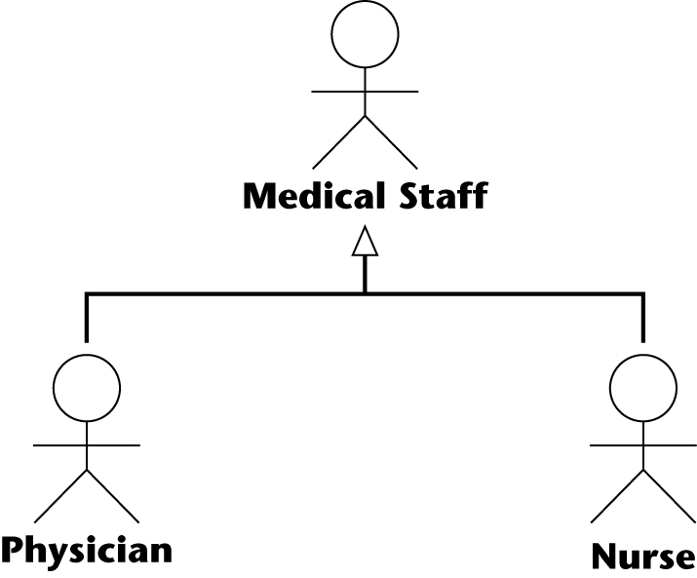
Overlapping Actors
Example:
One use case has actor Nurse; a different use case has actor Medical Staff
Better: Actors: Physician and Nurse

Slide 14
Initial Requirements
The initial requirements are based on the initial business model
Then they are refined
The requirements are dynamic — there are frequent changes
Maintain a list of likely requirements, together with use cases of requirements approved by the client

Slide 15
Functional vs Non-functional Requirements
A functional requirement specifies an action that the software product must be able to perform
Often expressed in terms of inputs and outputs
Handled as part of the requirements and analysis workflows
A nonfunctional requirement specifies properties of the software product itself, such as
Platform constraints; Response times; Reliability
Some nonfunctional requirements have to wait until the design workflow

Slide 16
MSG Case Study
The Martha Stockton Greengage (MSG) Foundation provides low cost mortgage loans to young couples
A mortgage is a loan in which real estate is used as security
The trustees commission a pilot project
A software product to determine how much money is available each week to purchase homes
Group discussion: what interview questions would you ask?

Slide 17
MSG Case Study: Initial Understanding
House costs: $100K
Loan: $90K (10% down payment)
Loan term: 30 years, repaid monthly
Interest rate: 7.5% per annum
0.625% per month
Monthly mortgage payment (P & I): $629.30
Interest on the outstanding balance + principal
First month: $562.50 (interest)+ $66.80 (principal)
After first month, the outstanding balance is $89,933.20
2nd month, interest at 0.625% on $89,933.20 is $562.08

Slide 18
Mortgage Payments: After 15 & 30 Years
After 15 years (180 months), the outstanding balance is $67,881.61
Monthly interest at 0.625% on $67,881.61 is $424.26
$205.04 of the monthly payment of $629.30 is used to reduce the principal
After 30 years (360 months), the entire loan will have been repaid

Slide 19
Insurance Premiums
MSG requires the borrower to insure the house
If the house burns down, the check from the insurance company will then be used to repay the loan
The insurance premium is paid once a year by MSG
MSG requires the borrower to pay monthly insurance installments
Deposited in an escrow account (a savings account)
The annual premium is then paid from the escrow account

Slide 20
Real Estate Taxes
Real-estate taxes paid on a home are treated the same way as insurance premiums
Monthly installments are deposited in the escrow account
The annual real-estate tax payment is made from that account

Slide 21
Borrowing Limits
A mortgage will not be granted unless the total monthly payment is less than 28% of the borrower’s total income
P & I + insurance premiums + real-estate taxes

Slide 22
Other Costs
MSG requires a lump sum up front in return for lending the money to the borrower
Typically, 1-2% of the principal (“2 points”)
For the $90,000 loan, this amounts to $1,800
Closing costs
Legal costs
Various taxes
…

Slide 23
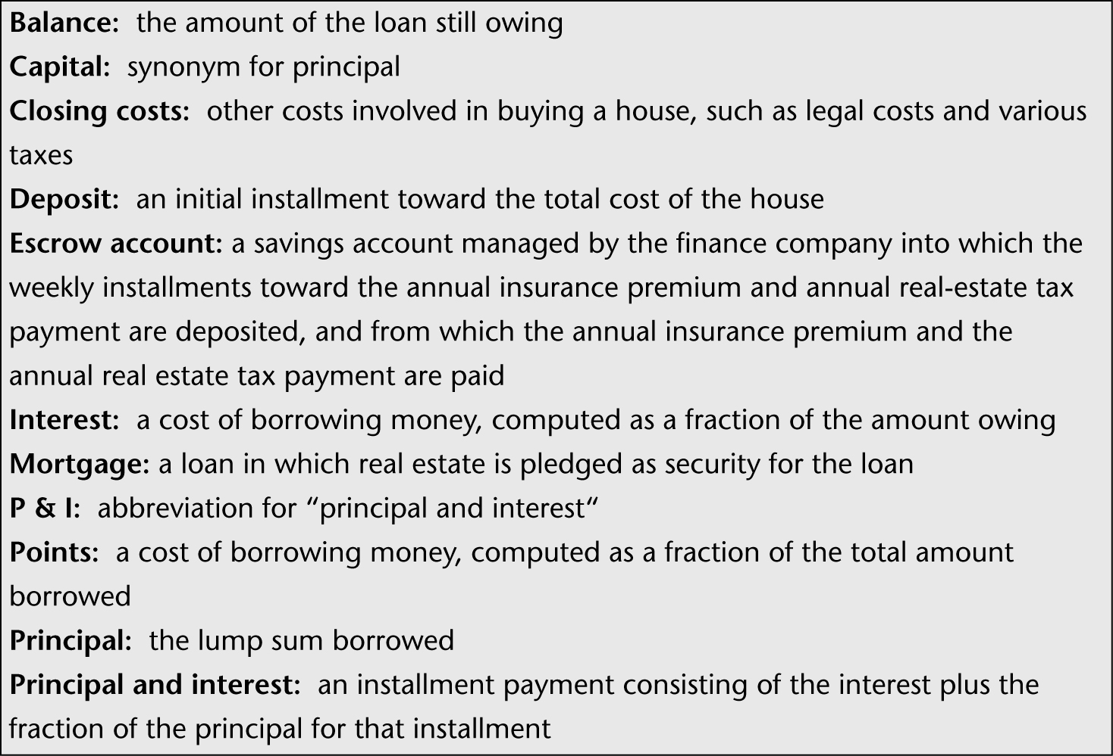
Initial Glossary

Slide 24
MSG Case Study: Initial Business Model
At the start of each week, MSG estimates how much money will be available to fund mortgages
Low-income couples can apply at any time
An MSG staff member determines
Whether the couple qualifies for a mortgage, and
Whether MSG has sufficient funds on hand to purchase the home
If so, the mortgage is granted
The weekly mortgage repayment is computed according to MSG rules

Slide 25
MSG Case Study: Initial Business Model (contd)
Three use cases
Estimate Funds Available for Week
Apply for an MSG Mortgage
Compute Weekly Repayment Amount

Slide 26
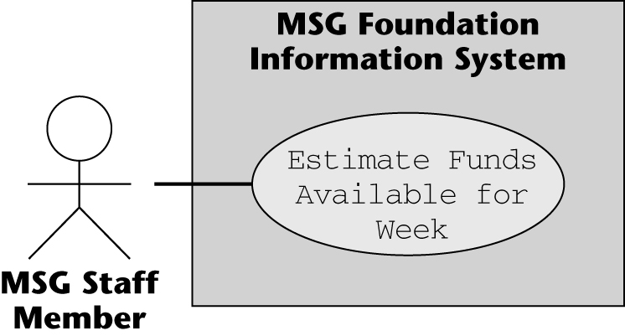
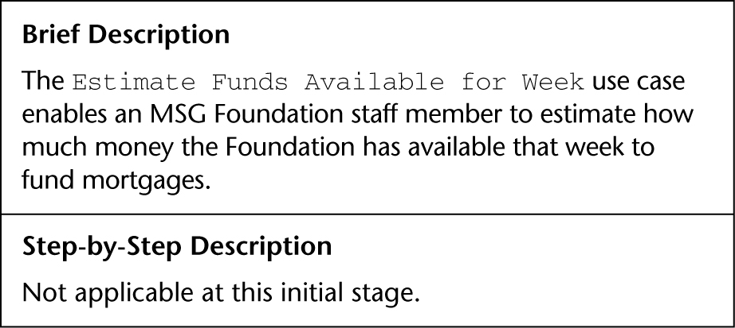
Estimate Funds Available for Week Use Case

Slide 27
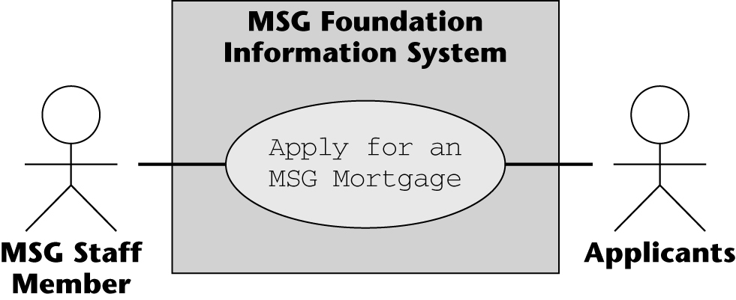
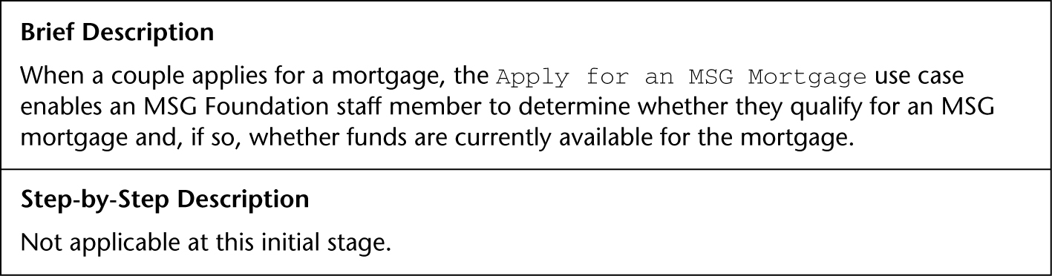
Apply for an MSG Mortgage Use Case
Notes:
Why is Applicants an actor? Applicants do not interact with the software
The applicants initiate the use case: Their answers are entered into the software product by an MSG staff member;
The real actor is therefore Applicants — the MSG Staff Member is merely an agent of the applicants

Slide 28
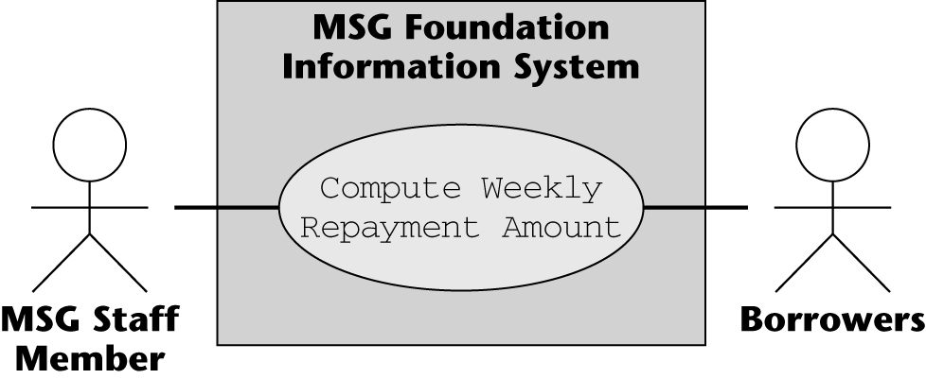
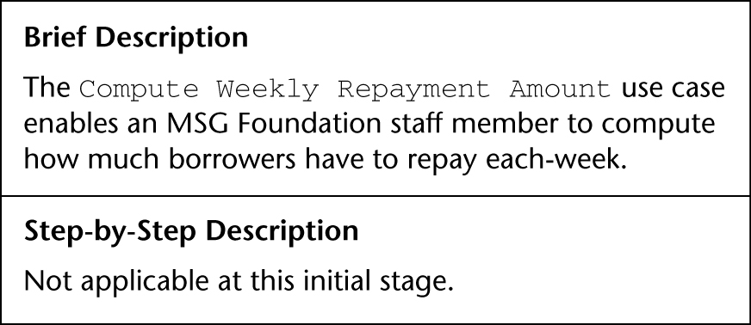
Compute Weekly Repayment Amount Use Case
Notes:
Borrowers is an actor. The use case is initiated by actor Borrowers. The information entered by MSG staff is supplied by the borrowers

Slide 29
Manage an Investment Use Case
At this stage, no details are known about
The buying and selling of investments, or
How investment income becomes available for mortgages
However, use case Manage an Investment is an essential part of the initial business model

Slide 30
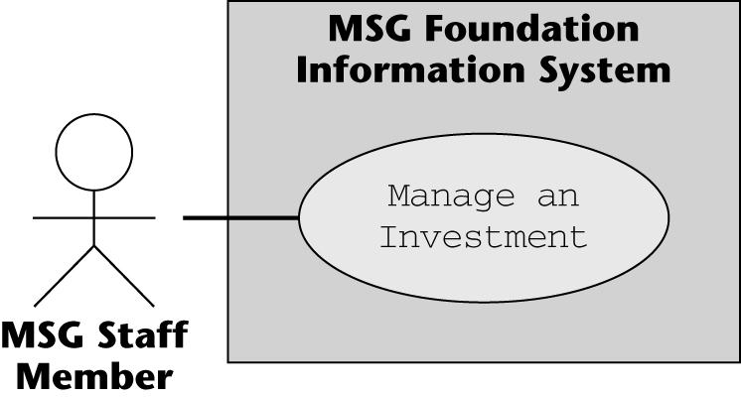
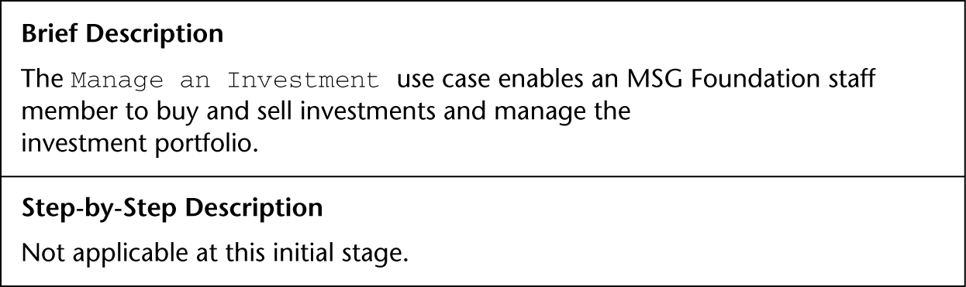
Manage an Investment Use Case (contd)

Slide 31
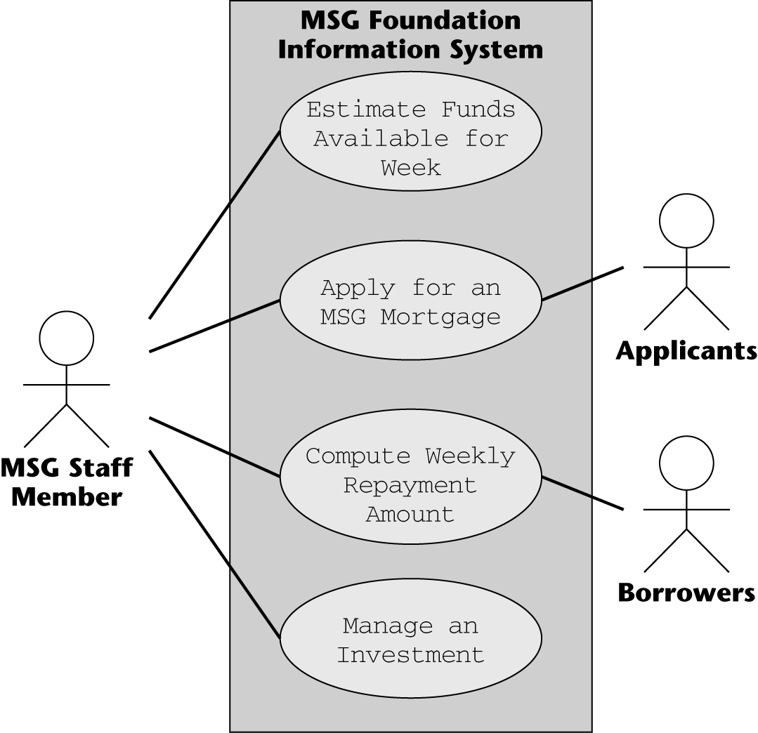
Use-Case Diagram of the Initial Business Model

Slide 32
MSG Case Study: Initial Requirements
It is unclear if all four use cases are all requirements of the product to be developed
What, exactly, is “a pilot project”?
The best way to proceed is
Draw up the initial requirements on the basis of what the client wants, and then iterate

Slide 33
MSG : Initial Requirements (contd)
Consider each use case in turn:
Estimate Funds Available for Week is obviously part of the initial requirements
Apply for an MSG Mortgage does not seem to have anything to do with the pilot project
Compute Weekly Repayment Amount, and Manage an Investment appear to be relevant
The pilot project deals with the “money that is available each week to purchase homes”
Comes from the weekly repayment of existing mortgages, and from income from investments

Slide 34
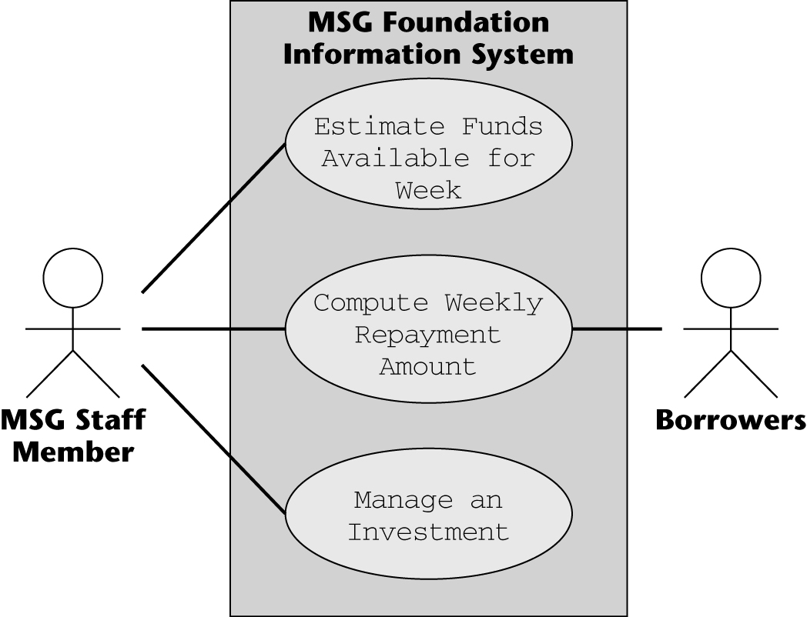
MSG: Initial Use-Case Diagram
The next step: Iterate the requirements workflow

Slide 35
MSG: Continuing the Requirements Workflow
The systems analysts learn that the MSG Foundation grants a 100% mortgage to buy a home under the following conditions:
The couple has been legally married for at least 1 year but not more than 10 years
Both husband and wife are gainfully employed
The price of the home must be below the published median price in that area for the past 12 months
Their income and/or savings are insufficient to afford a standard fixed-rate 30-year 90% mortgage
The foundation has sufficient funds to purchase the home

Slide 36
Conditions for an MSG Mortgage (contd)
If the application is approved, then each week for the next 30 years the couple pays MSG
The total of the principal and interest payment;
The escrow payment: (annual real-estate tax + annual homeowner’s insurance premium)/52
If this exceeds 28% of the couple’s gross weekly income, MSG pays the difference as a grant
The couple must provide proof of their income
The weekly payment may vary from week to week

Slide 37
Algorithm to Determine If Funds Are Available
At the beginning of the week, the estimated annual income from MSG investments is computed and divided by 52
The estimated annual MSG operating expenses are divided by 52
The total of the estimated mortgage payments for the week is computed
The total of the estimated grants for the week is computed

Slide 38
Algorithm to Determine If Funds Are Available
The amount available at the beginning of the week is then (1) - (2) + (3) – (4)
If the cost of the home is no more than (5), funds are provided to buy the home
At the end of each week, any unspent funds are invested

Slide 39
Requirements of the Pilot Project
To keep the cost as low as possible, only those data items needed for the weekly funds computation will be included
Only three types of data are needed:
Investment data
Operating expenses data
Mortgage data

Slide 40
Investment Data
Item number
Item name
Estimated annual return
Date estimated annual return was last updated

Slide 41
Operating Expenses Data
Estimated annual operating expenses
Date estimated annual operating expenses was last updated

Slide 42
Mortgage Data
Account number
Last name of mortgagees
Original purchase price of home
Date mortgage was issued
Weekly principal and interest payment
Current combined gross weekly income, date last updated
Annual real-estate tax, date last updated
Annual homeowner’s insurance premium, date last updated

Slide 43
Reports Required for the Pilot Project
Three types of reports are needed:
The results of the funds computation for the week
A listing of all investments (to be printed on request)
A listing of all mortgages (to be printed on request)

Slide 44
MSG: Revising the Requirements
The initial requirements include three use cases:
Estimate Funds Available for Week
Compute Weekly Repayment Amount
Manage an Investment
Now revise the requirement according to the formula for determining funds available

Slide 45
MSG: Revising the Requirements(contd)
(1) Estimated annual income from investments
Take all the investments, sum the estimated annual return on each investment, and divide the result by 52
Add use case, Estimate Investment Income for Week
We still need use case Manage an Investment for adding, deleting, and modifying investments

Slide 46
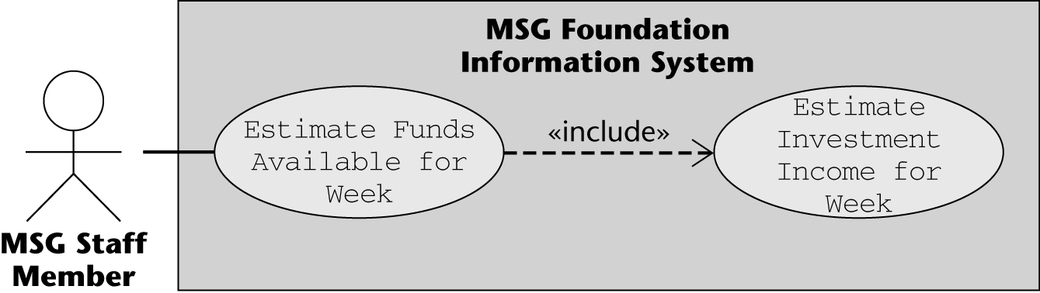
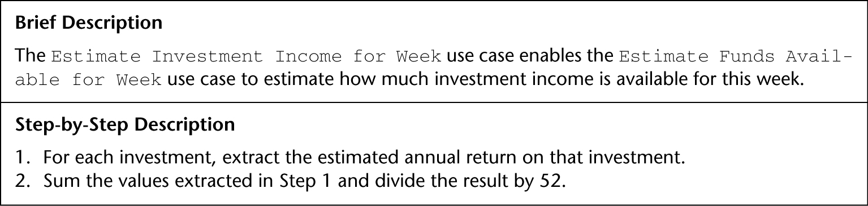
Estimate Investment Income for Week Use Case
Notes:
Use case Estimate Investment Income for Week is part of use case Estimate Funds Available for Week

Slide 47
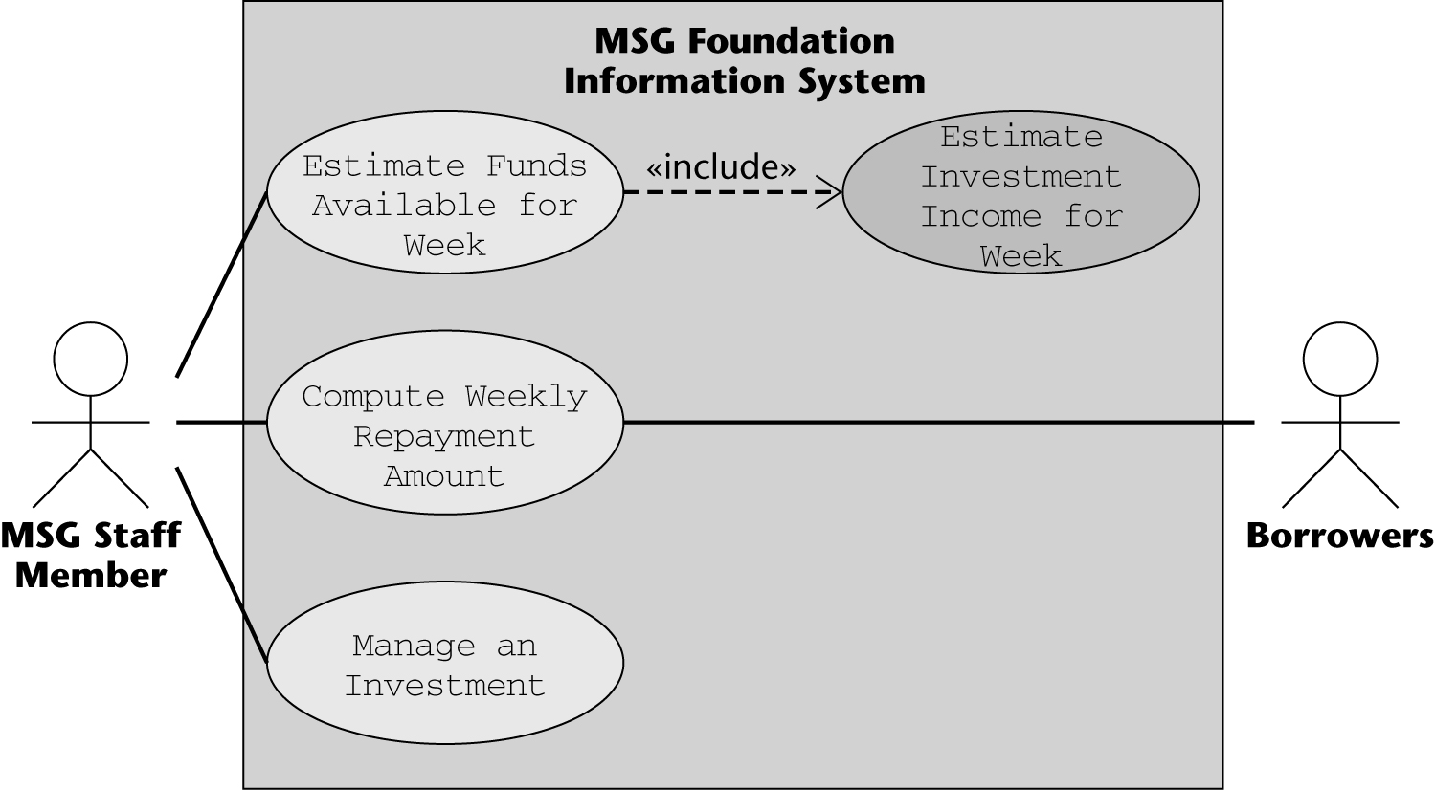
1st Iteration of the Revised Use-Case Diagram
Notes:
New use case is shaded

Slide 48
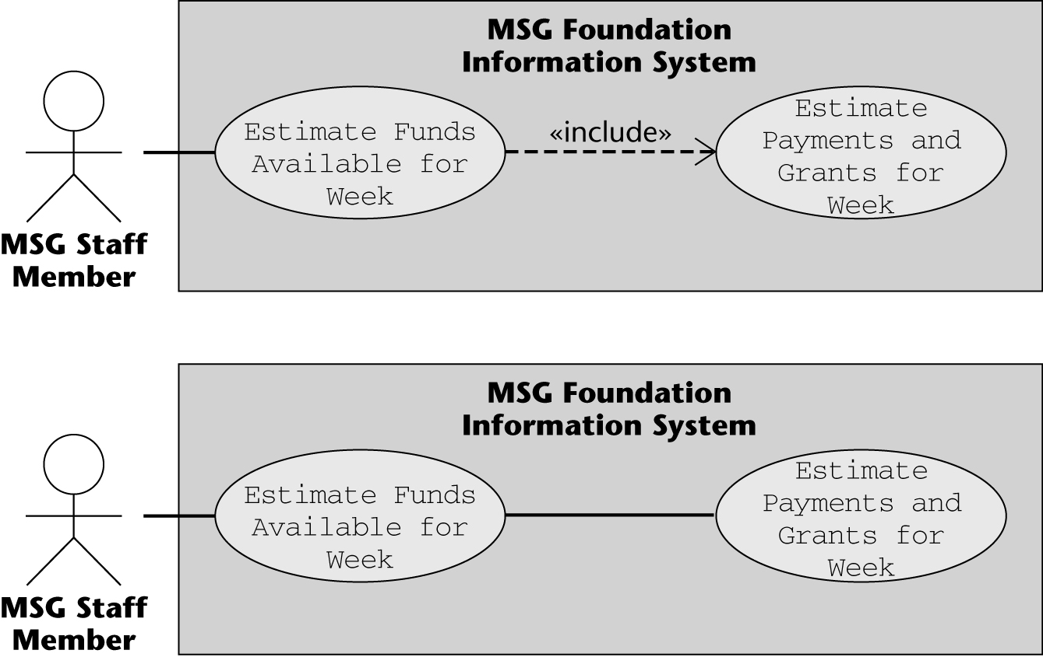
«include» Relationship
Correct use case
incorrect use case
Notes:
The bottom diagram models use cases Estimate Funds Available for Week, and Estimate Payments and Grants for Week
As two independent use cases, however, a use case models an interaction between the product itself and users of the product (actors)
Use case Estimate Payments and Grants for Week does not interact with an actor and therefore cannot be a use case in its own right
Instead, it is a portion of use case Estimate Funds Available for Week, as reflected in the top diagram

Slide 49
MSG: Revising the Requirements (contd)
(2) Estimated annual operating expenses:
Add two use cases
Use case Update Estimated Annual Operating Expenses models adjustments to the value of the estimated annual operating expenses
Use case Estimate Operating Expenses for Week provides the needed estimate of the operating expenses

Slide 50
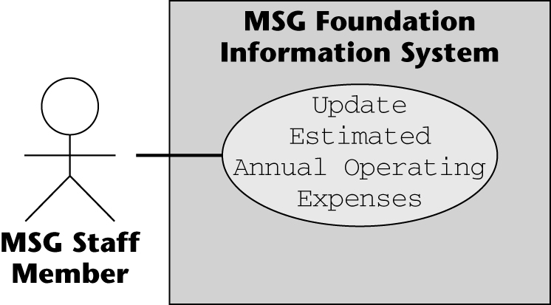
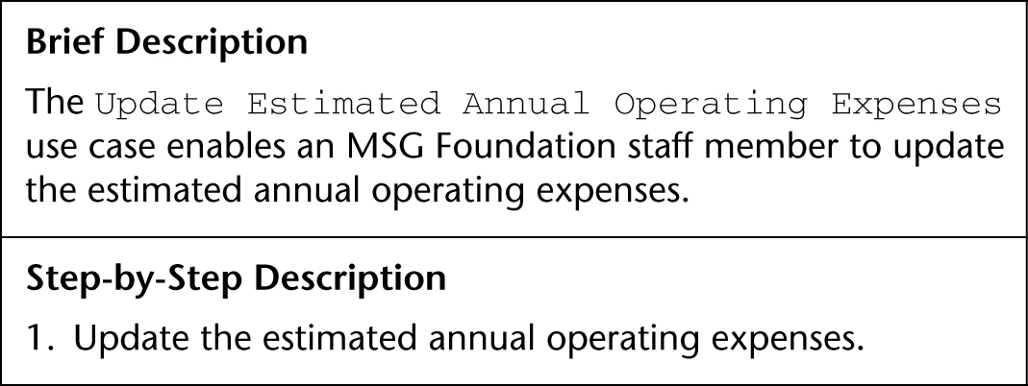
Update Estimated Annual Operating Expenses Use Case

Slide 51
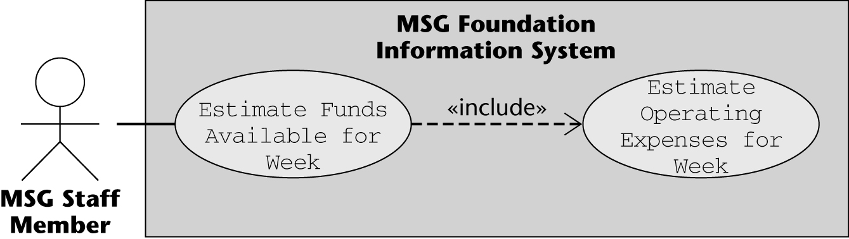
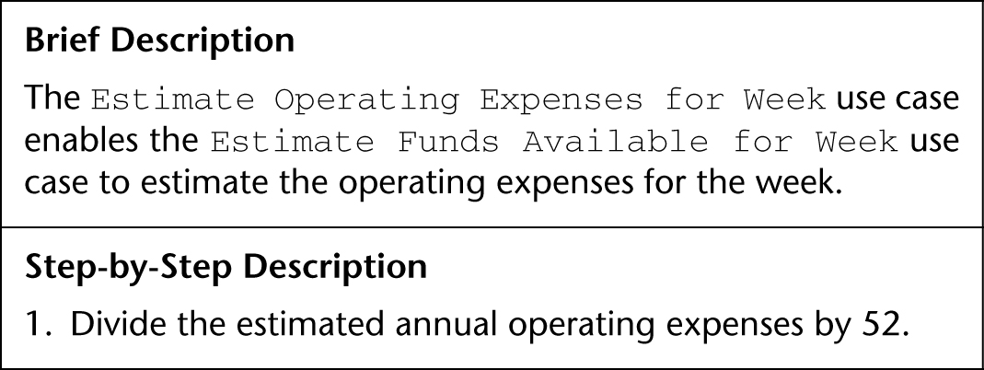
Estimate Operating Expenses for Week Use Case (contd)

Slide 52
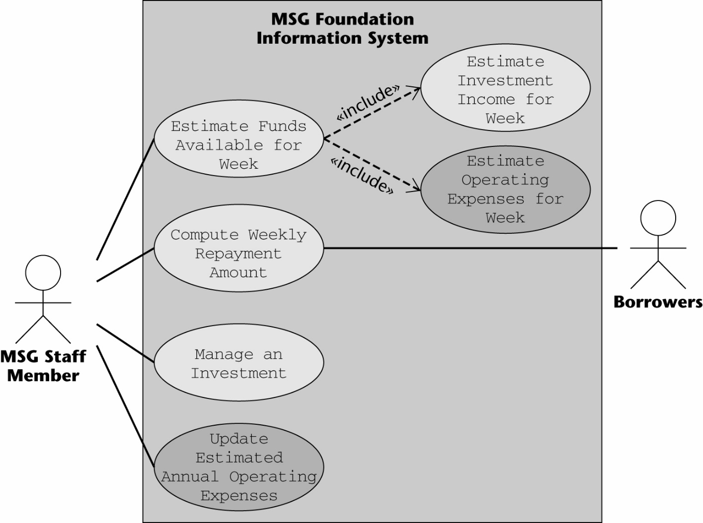
2nd Iteration of Revised Use-Case Diagram
Notes:
The new use cases are shaded

Slide 53
MSG: Revising the Requirements: (contd)
(3) Total estimated mortgage payments for the week
(4) Total estimated grant payments for the week
Add case Compute Weekly Repayment Amount
Computes both the estimated mortgage payment and the estimated grant payment for each mortgage
Add case Update Borrowers’ Weekly Income
Grant payment= total payment - borrowers income
Weekly income needs to be updated once in a while

Slide 54

Estimate Payments and Grants for Week Use Case

Slide 55
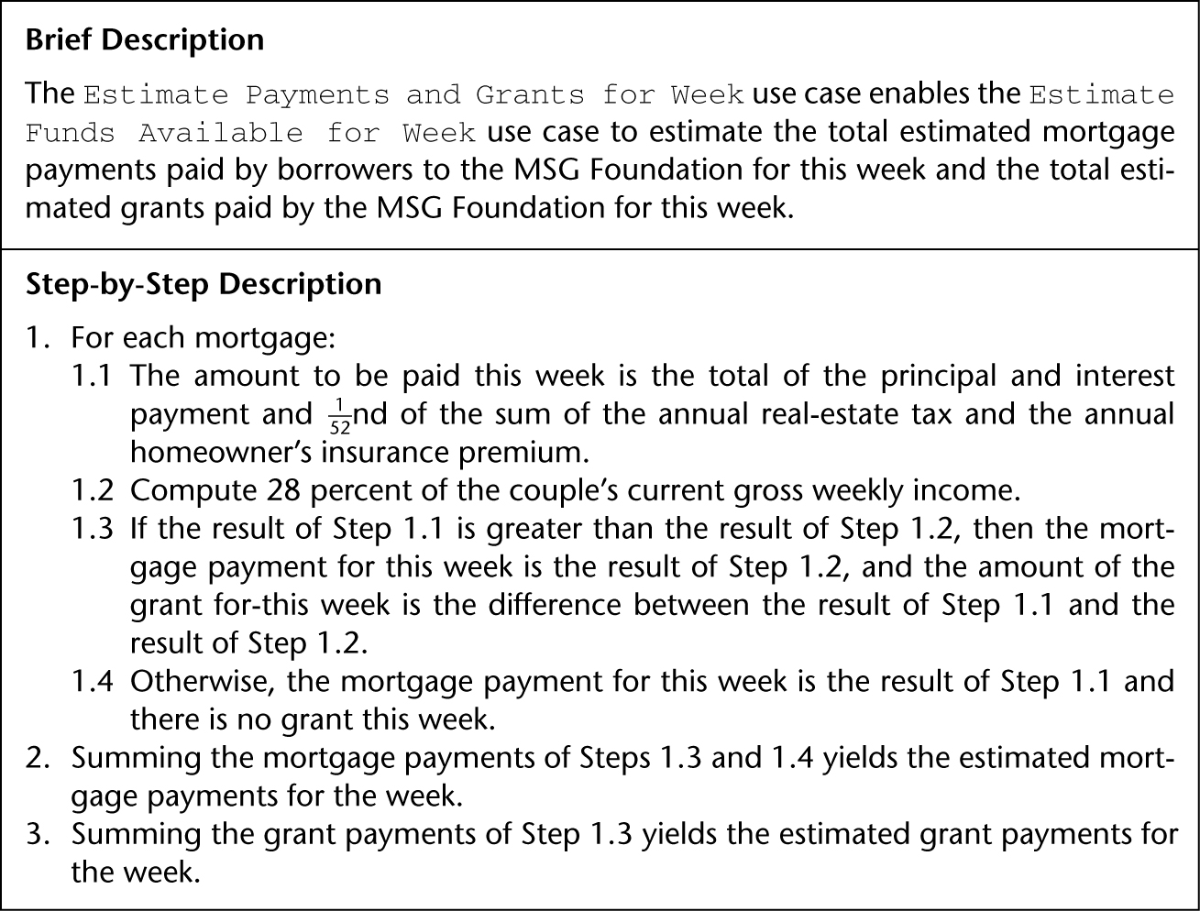
Estimate Payments and Grants for Week Use Case (contd)

Slide 56
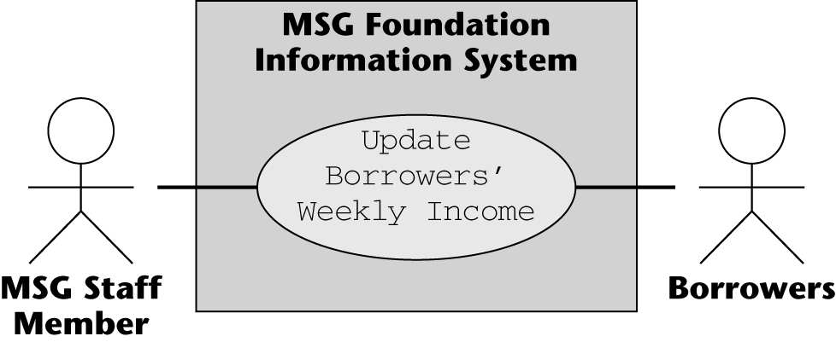
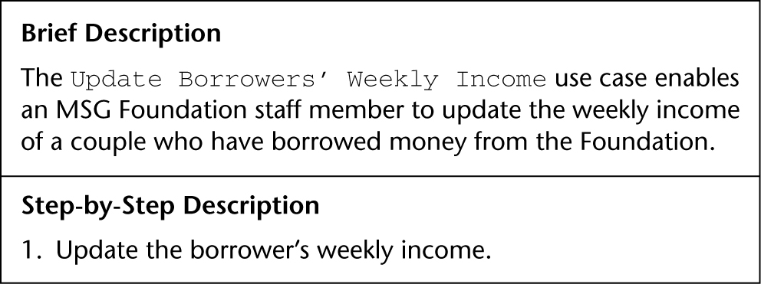
Update Borrowers’ Weekly Income Use Case

Slide 57
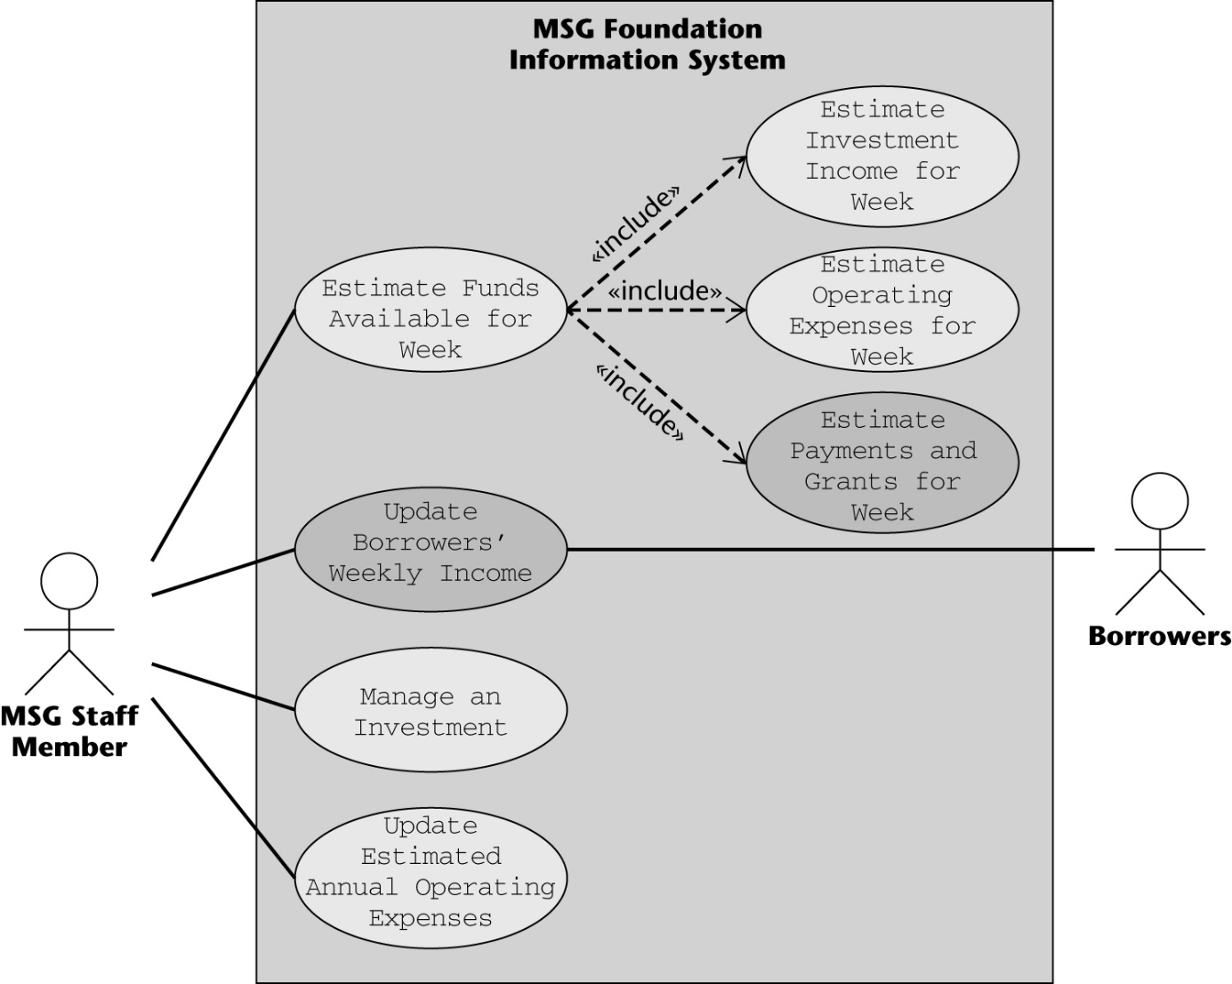
3rd Iteration of the Revised Use-Case Diagram
Notes:
The two new use cases are shaded

Slide 58
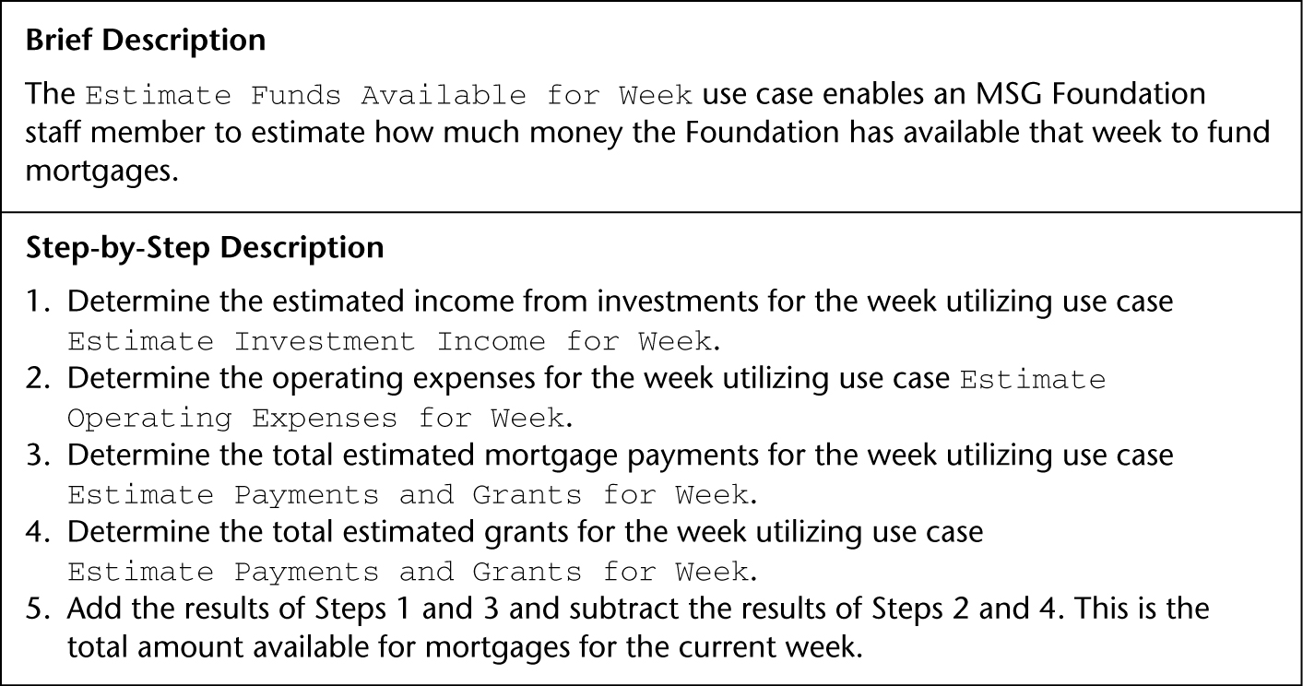
Estimate Funds Available for Week : Updated Use Case Decription
Notes:
The compuation uses the data obtained from three other use cases
Estimate Investment Income for Week
Estimate Operating Expenses for Week
Estimate Payments and Grants for Week

Slide 59
MSG: The Test Workflow:
A common side-effect of the iterative and incremental life-cycle model
Details that correctly have been postponed somehow get forgotten
Details of Manage an Investment overlooked
Manage a Mortgage has been totally forgotten
Addition, modification, removal of mortgage
Analogous to Manage an Investment

Slide 60
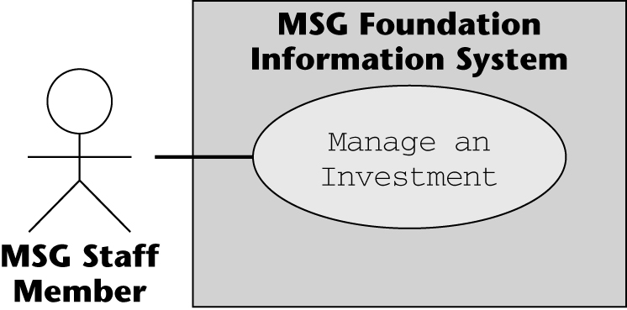
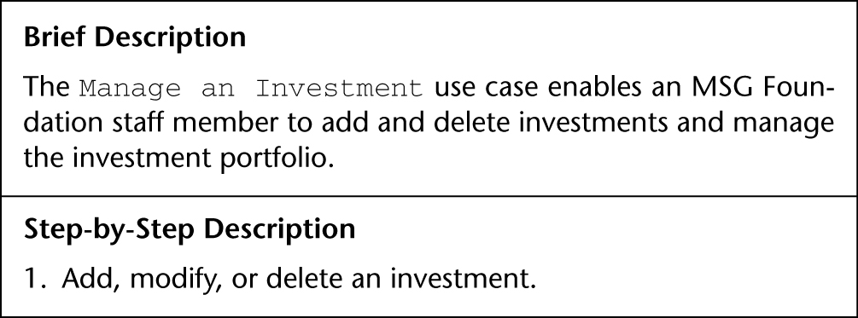
Manage an Investment Use Case

Slide 61
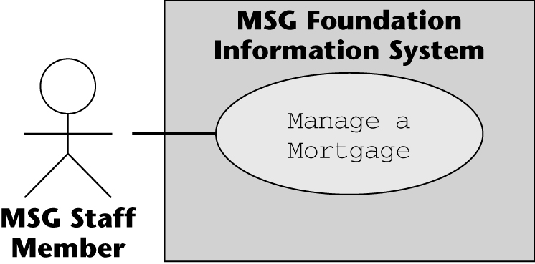
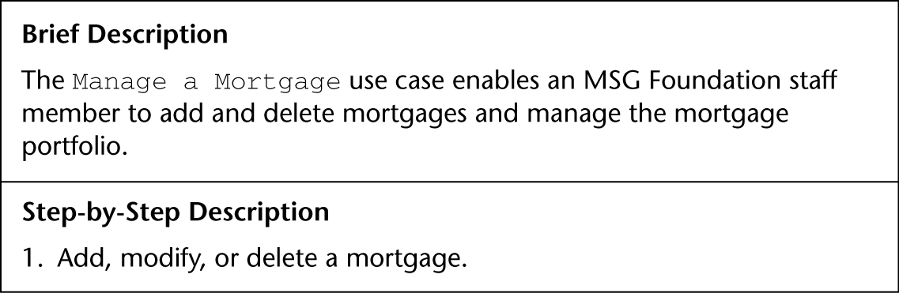
Manage a Mortgage Use Case

Slide 62
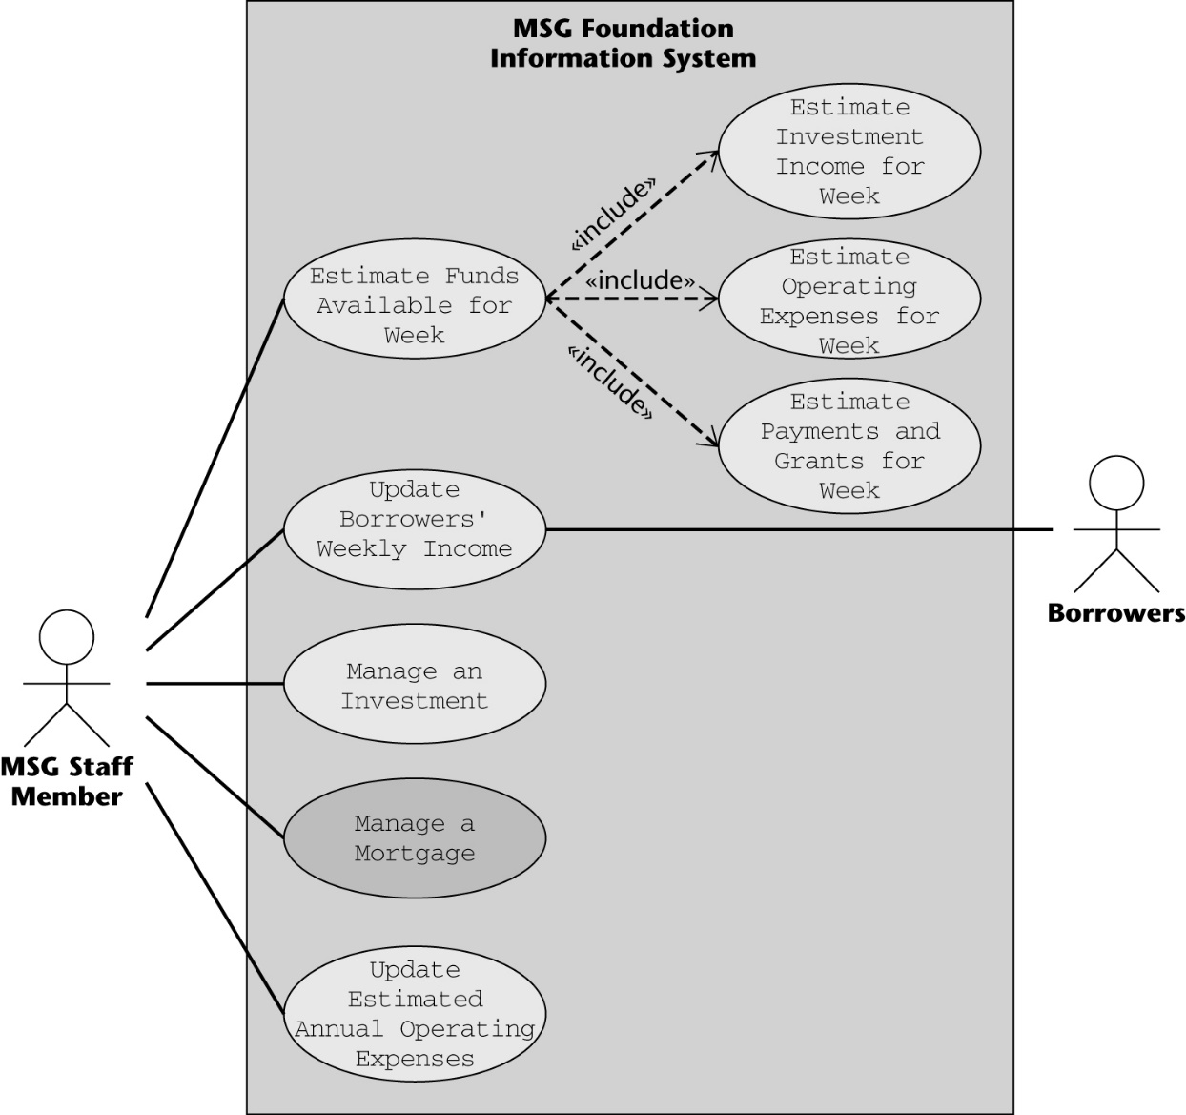
4th Iteration of the Revised Use-Case Diagram

Slide 63
MSG: The Test Workflow (contd)
There is a further omission
Use case Produce a Report to print the three reports has also been totally forgotten
Investments report
Mortgages report
Results of weekly computation

Slide 64
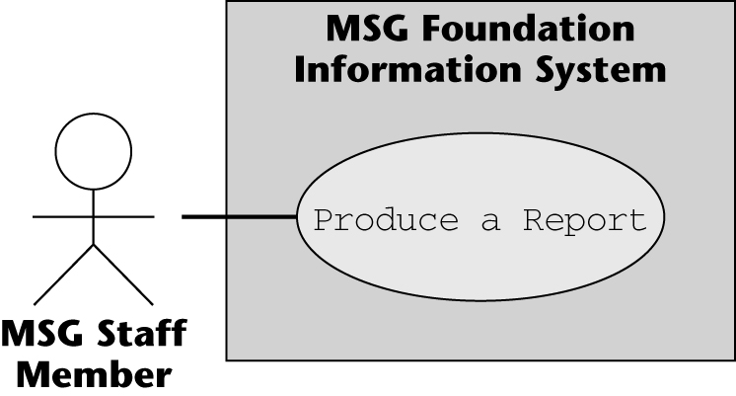
Produce a Report Use Case

Slide 65
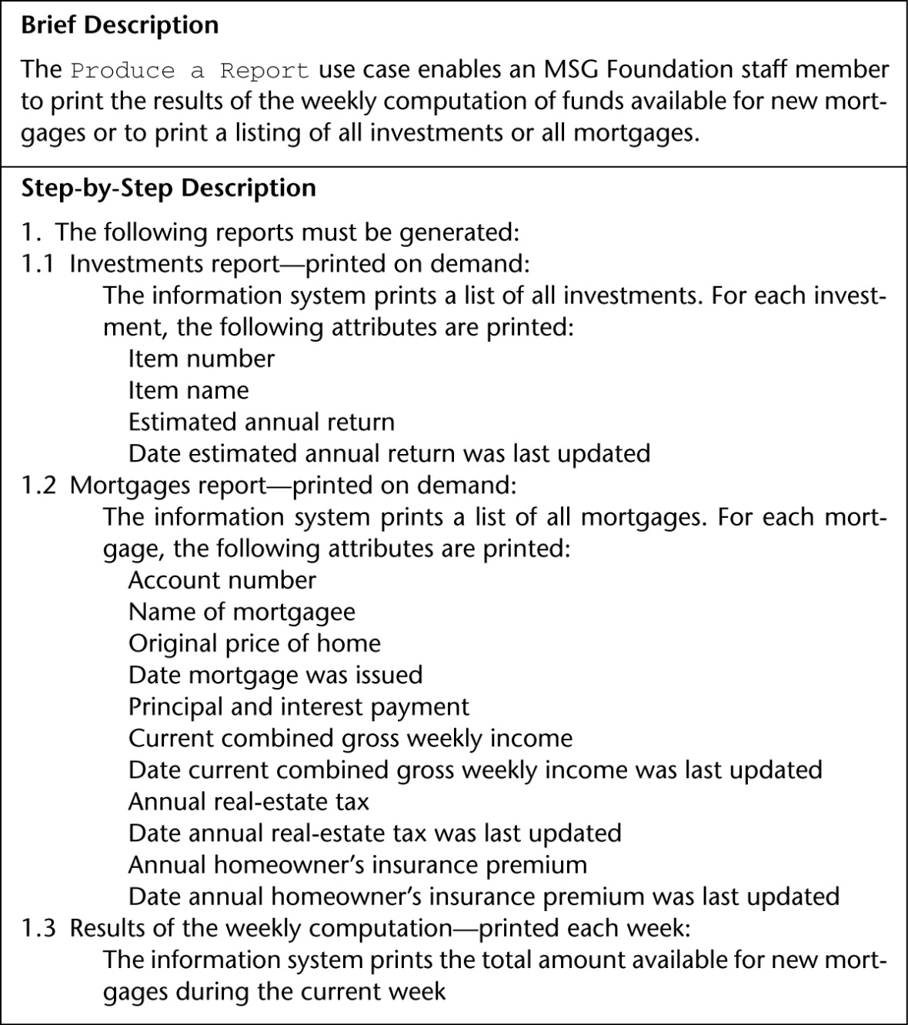
Produce a Report Use Case (contd)

Slide 66
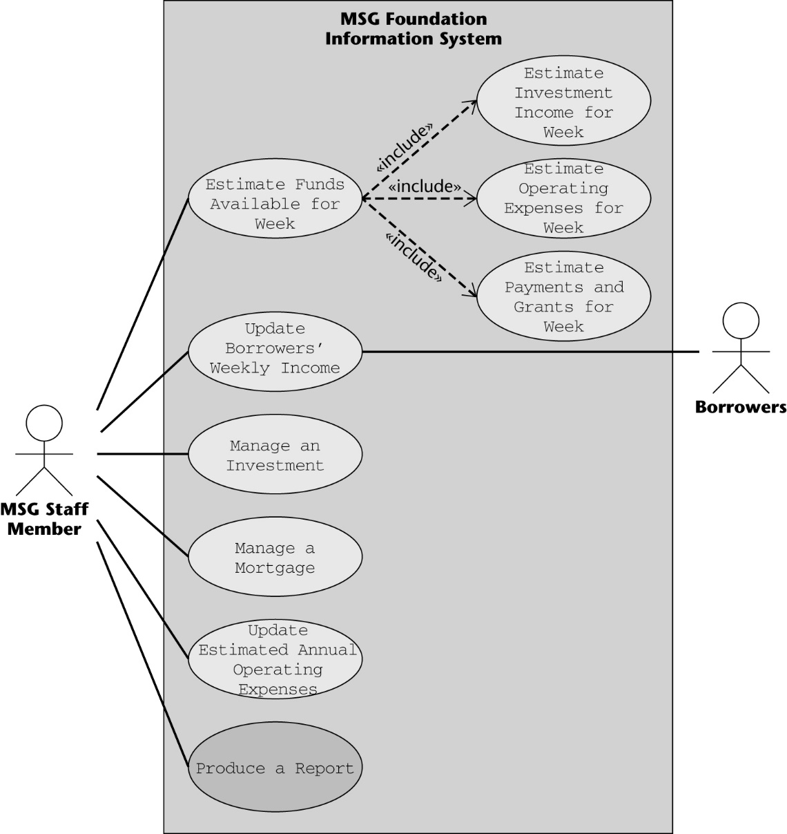
5th Iteration of the Revised Use-Case Diagram
More problems?
Notes:
Duplication: Manage a Mortgage already includes Update Borrowers’ Weekly Income
Borrowers’ weekly income is an attribute of the mortgage.
(2) Estimate Funds Available for Week and Produce a Report need to be reorganized
Estimate Funds Available for Week models performing the calculation;
Step 1.3 of use case Produce a Report (previous slide) prints out the result of the computation;
There is no point in estimating the funds available unless the results are printed out.

Slide 67
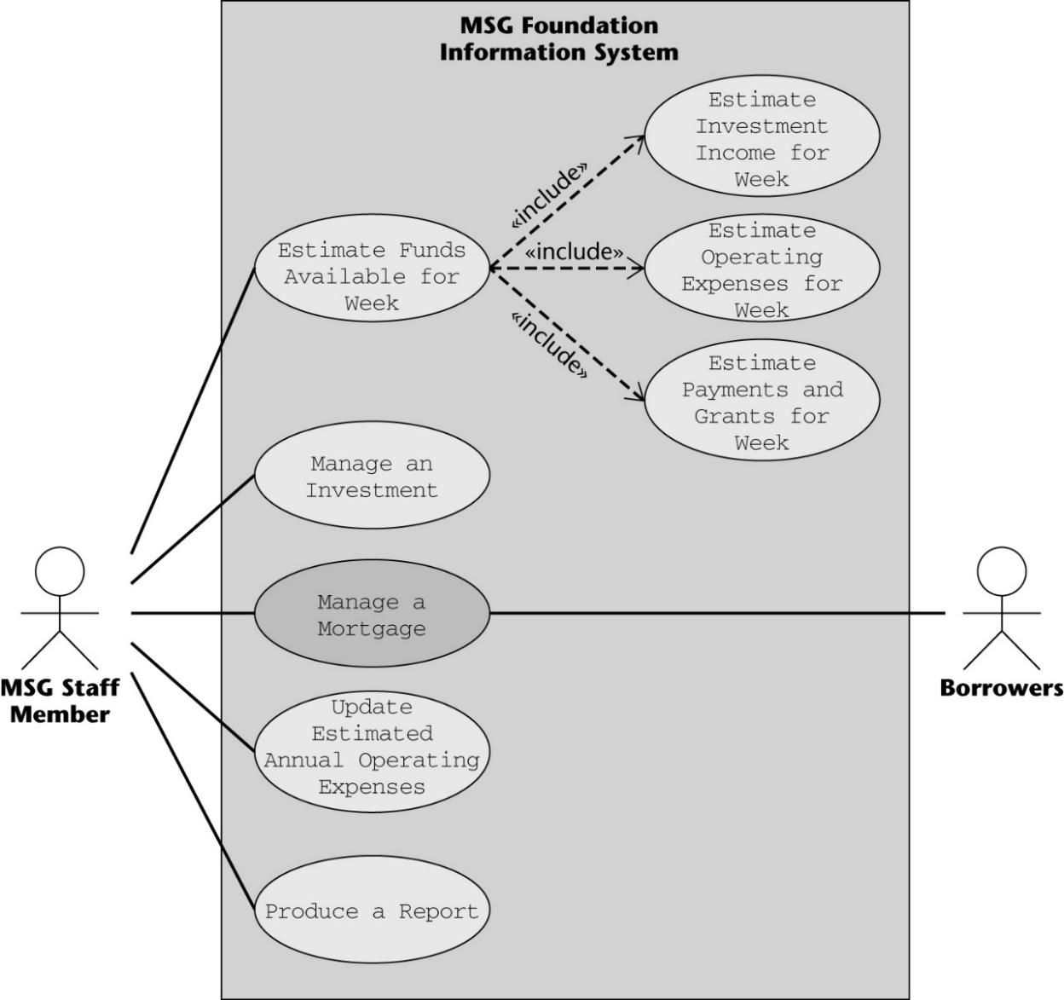
6th Iteration of the Revised Use-Case Diagram
Delete update Borrowers’ Weekly Income
Manage a Mortgage already includes Update Borrowers’ Weekly Income

Slide 68
6th Iteration - cont
This iteration resulted in a decrement, not an increment
Deletion occurs often: whenever we make a mistake
Sometimes we can fix an incorrect artifact
More frequently we have to delete an artifact
When we discover a fault, we do not have to start the whole process from scratch
First we try to fix the current iteration
If the mistake is too serious, we backtrack to the previous iteration

Slide 69
Reorganizing Two Use Cases
Use case Estimate Funds Available for Week models performing the calculation
Step 1.3 of use case Produce a Report to printout the result of the computation
There is no point in estimating the funds available unless the results are printed out
The use case descriptions have to be modified.
the use cases do not change

Slide 70
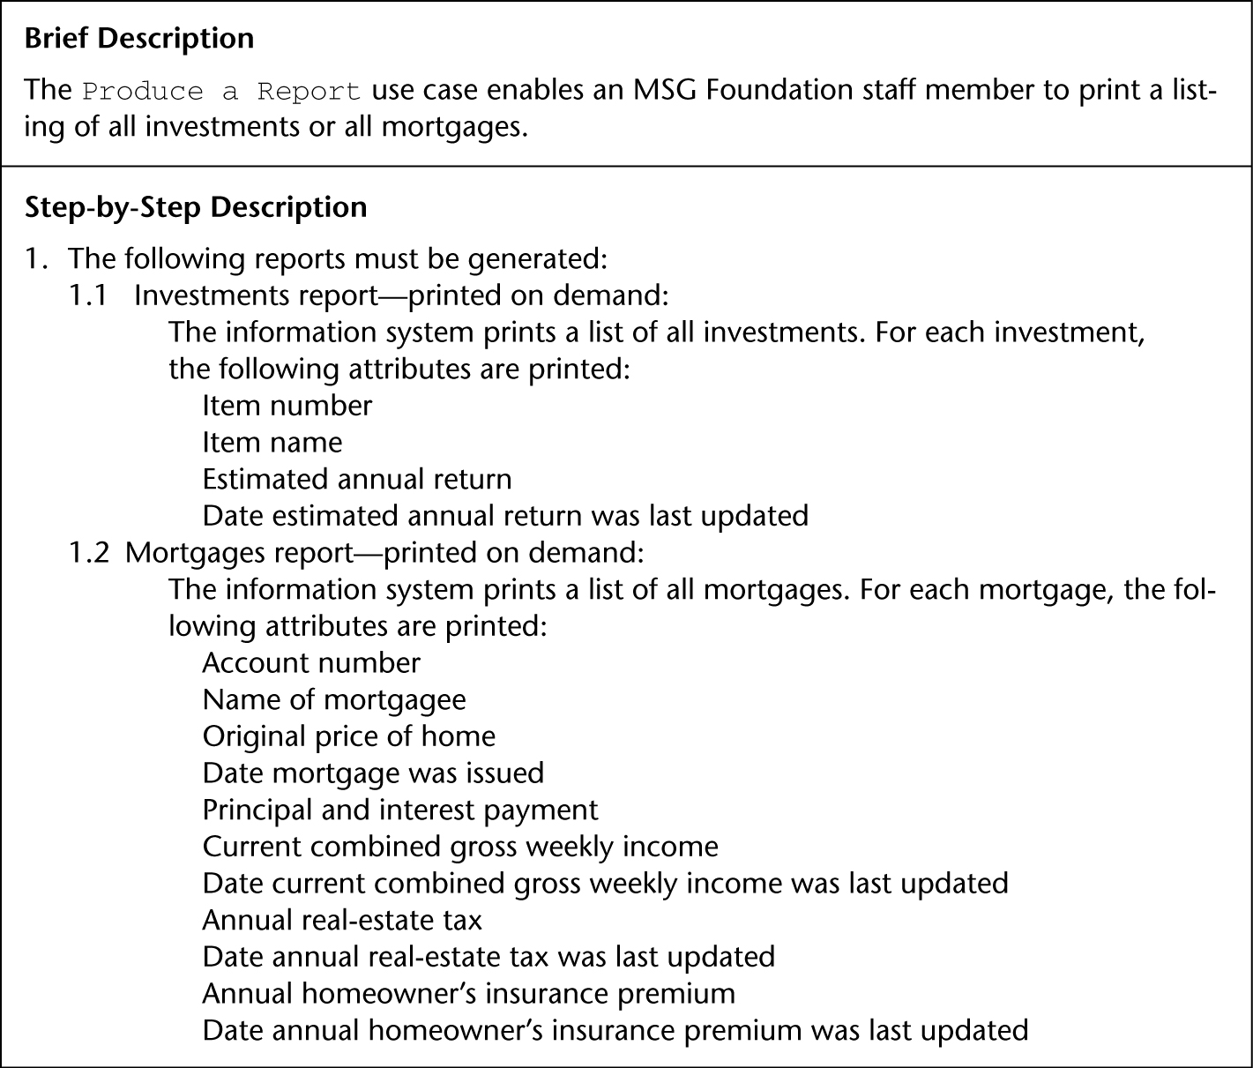
Modified Description — Produce a Report
1.3 removed.

Slide 71
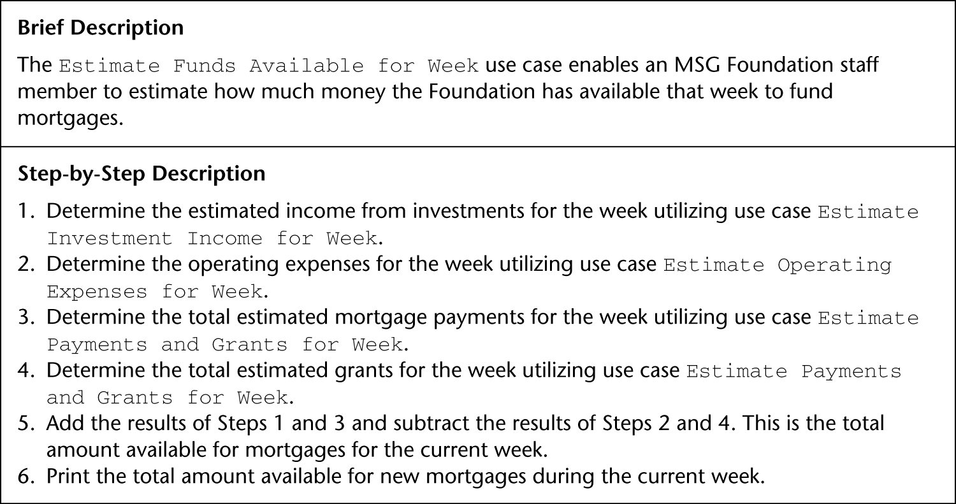
Modified Description — Estimate Funds Available for Week
Added:

Slide 72
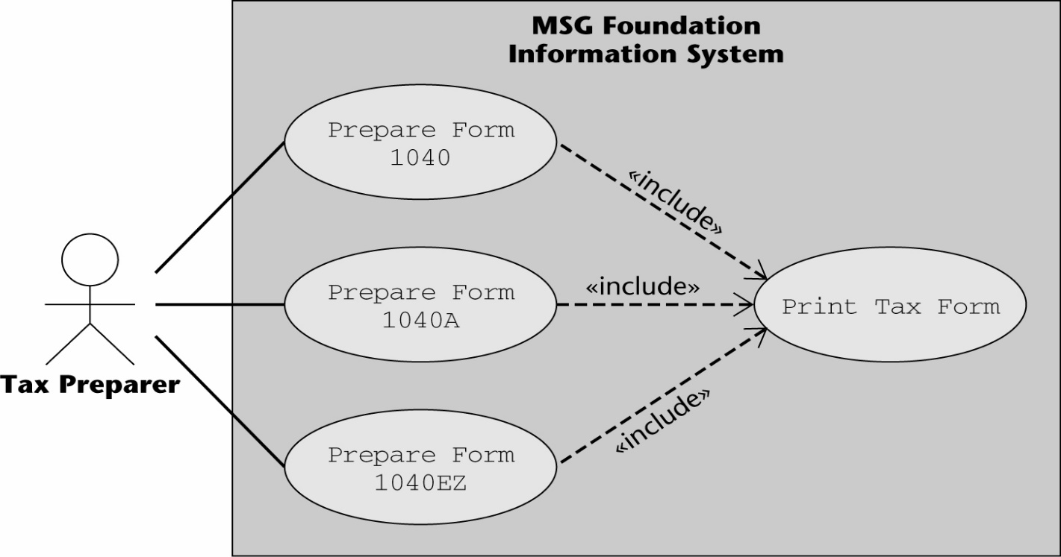
MSG: The Test Workflow (contd)
The usual reason for an «include» relationship is where one use case is part of two or more other use cases
Example: U.S. tax forms — avoiding triplication

Slide 73
Estimate Funds Available for Week Use Case (contd)
For the MSG case study
All of the included use cases are part of only one use case, Estimate Funds Available for Week
Incorporate those three «include» use cases into use case Estimate Funds Available for Week
The resulting use-case diagram is on the next slide

Slide 74
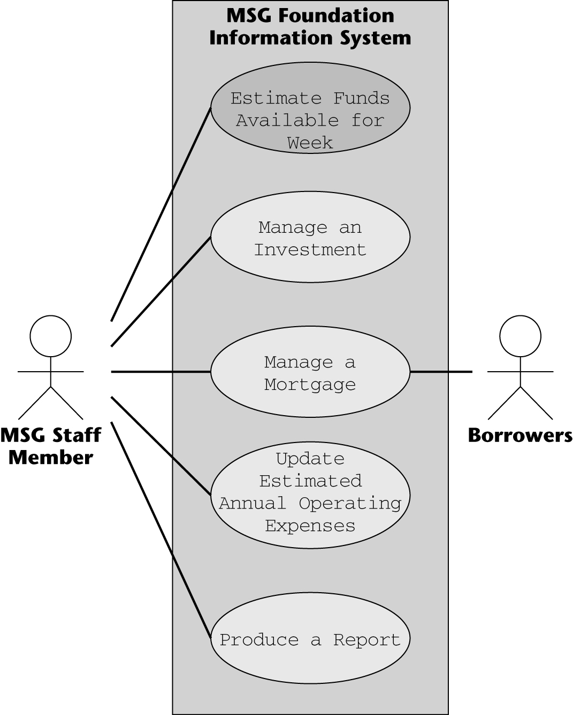
7th Iteration of Revised Use-Case Diagram

Slide 75
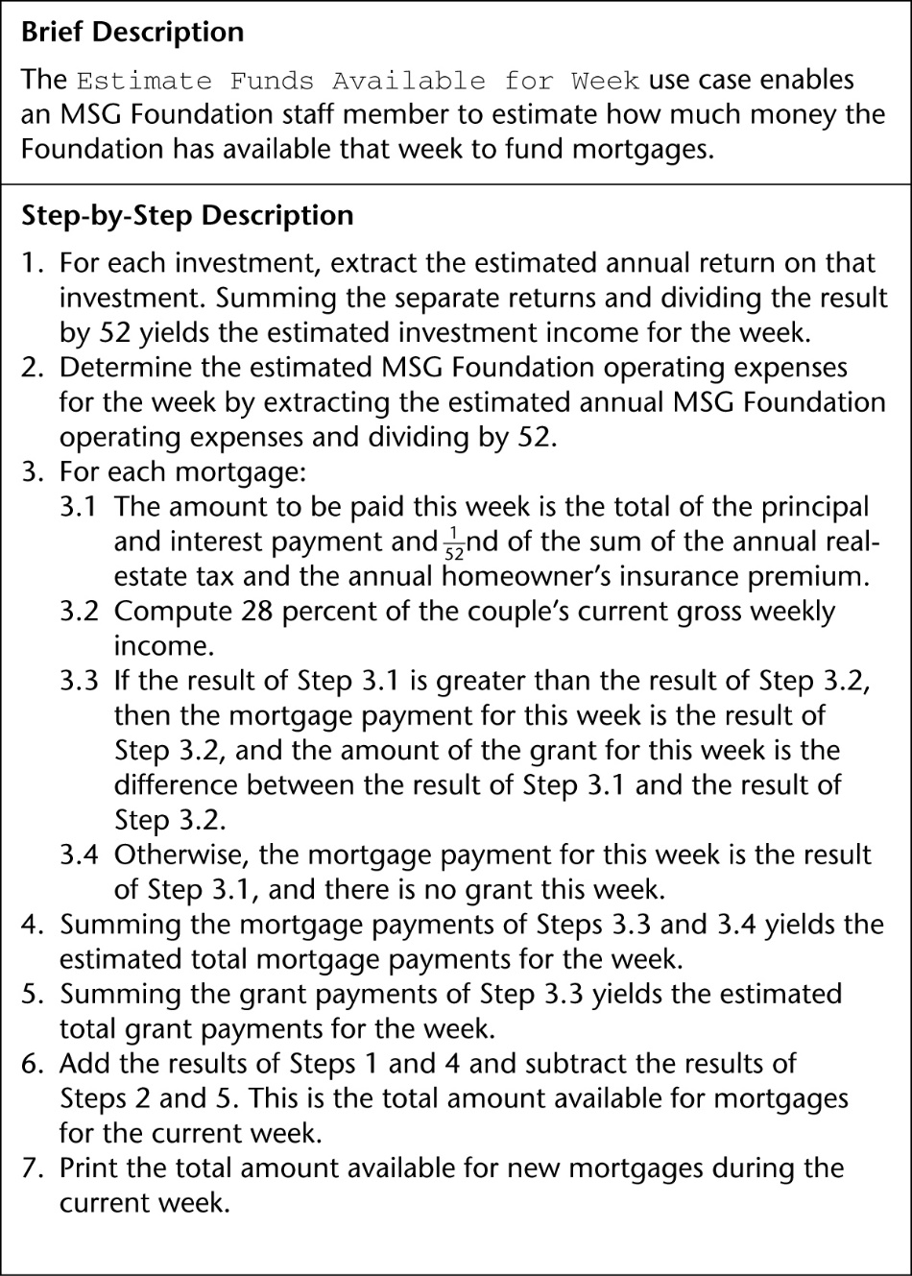
Estimate Funds Available for Week Revised Description of Use Case

Slide 76
MSG: The Test Workflow (contd)
Now the requirements appear to be correct
They correspond to what the client has requested
They appear to satisfy the client’s needs
There do not seem to be any more faults
For now, everything seems to be fine

Slide 77
What are Object-Oriented Requirements?
There is no such thing as “object-oriented requirements”
The requirements workflow has nothing to do with how the product is to be built
However, the approach presented here is
Model-oriented, and object-oriented (textbook?)

Slide 78
Rapid Prototyping
Aim: provide the client with an understanding of the product
Hastily built (“rapid”): Imperfections can be ignored
Exhibits only key functionality
Emphasis on only what the client sees
Error checking, file updating can be ignored
A rapid prototype is built for change

Slide 79
Rapid Prototyping of HCI
Rapid prototype of the HCI is often obligatory
Human-computer interface (HCI)
Menu, not command line
“Point and click”
Windows, icons, pull-down menus
Human factors must be taken into account
Avoid a lengthy sequence of menus
Allow the expertise level of an interface to be modified
Uniformity of appearance is important
Advanced psychology vs. common sense?

Slide 80
Reusing the Rapid Prototype
Reusing a rapid prototype is essentially code-and-fix
Changes made to a working product are expensive
Maintenance is hard without specification and design documents
Real-time constraints are hard to meet

Slide 81
Reusing the Rapid Prototype (contd)
One way to ensure the prototype is discarded
Implement it in a different language from that of the target product
Generated code can be reused
We can safely retain (parts of) a rapid prototype if
This is prearranged
Those parts pass SQA inspections
However, this is not “classical” rapid prototyping

Slide 82
CASE Tools for the Requirements Workflow
We need graphical tools for UML diagrams
To make it easy to change UML diagrams
The documentation is stored in the tool and therefore is always available
Such tools are sometimes hard to use
The diagrams may need considerable “tweaking”
Overall, the strengths outweigh the weaknesses
Sample CASE environments
IBM Rational Rose
ArgoUML: http://argouml.tigris.org/
Eclipse UML2 Tools

Slide 83
Metrics for the Requirements Workflow
Volatility and speed of convergence are measures of how rapidly the client’s needs are determined
The number of changes made during subsequent phases
Changes initiated by the developers
Too many changes can mean the process is flawed
Changes initiated by the client
Moving target problem

Slide 84
Challenges of the Requirements Phase
Employees of the client organization often feel threatened by computerization
The requirements team members must be able to negotiate
The client’s needs may have to be scaled down
Key employees of the client organization may not have the time for in-depth discussions
Flexibility and objectivity are essential

Slide 85
How Developers See Users
Users don’t know what they want
Users can’t articulate what they want
Users are unable to provide a usable statement of needs
Users have too many needs
Users want everything now
Users can’t remain on schedule
Users can’t prioritize needs
Users are unwilling to comprise
Users refuse to take responsibility for the system
Users are not committed to development projects
Shari L. Pfleeger and Joanne M. Atlee, Software Engineering: Theory and Practice, 3rd Edition, Prentice-Hall, 2006.

Slide 86
How Users See Developers
Developers don’t understand operational needs
Developers can’t translate clearly stated needs into a successful system
Developers set unrealistic standards for requirements def.
Developers place too much emphasis on technicalities
Developers are always late
Developers can’t respond quickly to changing needs
Developers are always over budget
Developers say “no” all the time
Developers try to tell us how to do our jobs
Developers ask users for time and effort, even to the detriment of the users’ important primary duties

Slide 87
